Slide 1
XML Data Input
PrintNet T

Slide 2
Context Schema
Workflow
Data Input
&
Manipulation
Document
Design
(Layout)
Impositioning
Approval (Proof)
Spool Production
Notes:
Every workflow can contain modules in the above mentioned parts.
Each part has a different functionality:
Data input, data importing, data preparation
Designing and creating a document
Rotating or resizing a document
Viewing how the document might look like after leaving a printer
Sending the document for printing and specifying properties of the printing (and perhaps the format of the output file)

Slide 3

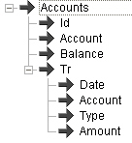
XML Data Input – Overview
XML files contain complex, multi-level data structures
XML is a universally recognized data format
XML Data Input module allows data from an XML file to be imported
It is possible to specify which data should be imported and what their occurrence is
Notes:
This multi-level option serves for designing complex data structures (e.g., joint statements for customers of utilities companies, telecom companies, etc.).
Without XML, users will have to merge more files (CSV, DBF, TXT) in order to have such a complex structure. With XML, it is possible to avoid this problem. From a time optimizing standpoint, it is more efficient to use the XML Data Input module and process an XML file with it than it is to merge several input files and create a complex structure by merging. It can be verified by Profile Data Tool in Workflow window.
XML Data Input module loads an XML file with a definable text encoding and an optional reading of the XML structure definition from external XSD files.
XML can be read as script as well.
Data occurrence – whether the data appears zero times, once or more, etc.

Slide 4


XML Data Input – Example
XML file – XML Data Input
  DTD and XSD
TSD file – Internal Data Input
RDI file – SAP Data Input
Notes:
XMLDataInput_InternalDataInput_SAPDataInput.wfd (XML Data Input module has Flights1.xml as an input file)
The imported structure definition files must exactly match the imported file otherwise there will be an error.
1. Show and explain XML in notepad viewer and show import to PrintNet T. PrintNet T can import XML and generate its data definition:
Directly from XML – generate and read XML schema
By XSD definition (XML Data Input, Internal Data Input, SAP Data Input.xsd) – first show XSD file in notepad, then read XML schema
By DTD definition (XML Data Input, Internal Data Input, SAP Data Input.dtd) – first show DTD file in notepad, then read DTD schema
2. View structure in Layout, view data in Data Proof. Use Read XML to import a structure definition ().
3. TSD (Internal Data Input) is an internal format developed by GMC which contains a definition. Used for loading the data files already stored in PrintNet T format. You can save a file in this format by selecting a Data Output module and set it (in its configuration) to be saved in the TSD file format. Its main advantage is that it is the fastest data import into PrintNet T.
4. RDI (SAP Data Input) SAP import – RDI is one of the lesser recommended data formats. Its advantage is that it is a SAP product and therefore PrintNet T supports it. SAP is regarded as one of the best programs (or tool collection) for collection and processing of data of big enterprises. One RDI file contains one record with some sub-records or arrays missing. The internal structure is not optimized. There might be some unknown arrays containing important information as well. When processing multiple RDI files (each containing one record), it is advisable to merge all these files together and make sure that they all have all required arrays inside. Also, one of the other disadvantages is that PrintNet T has to browse through the whole RDI file in order to have the overview of the internal structure.

Slide 5
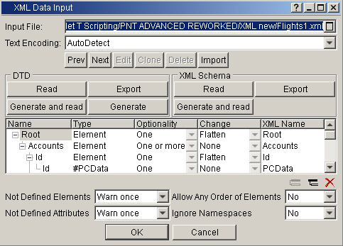
XML Input
Input File
Text Encoding
Notes:
Specifies the location of the XML file containing the data.
Specifies the encoding used in the XML file so that all characters are displayed correctly.
Other combo boxes:
Not defined elements – Define what should happen when the parser finds an element that is not defined in the structure. The options are:
Ignore – Nothing happens when a not defined element is found
Warn once – Warns only once on the first occurrence of a not defined element
Warn every time – Warns every time a not defined element is found
Error – Reports an error when a not defined element is found
Not defined attributes – Defines what should happen when the parser finds an attribute that is not defined in the structure. The options are:
Ignore – Nothing happens when a not defined attribute is found
Warn once – Warns only once on the first occurrence of a not defined attribute
Warn every time – Warns every time a not defined attribute is found
Error – Reports an error when a not defined attribute is found
Allow any order of elements
When set to “Yes”, it is not necessary to maintain the same order of elements in the XML file as defined in the structure.
Ignore name spaces
Name space is:
XML syntax that prevents name collisions in documents by qualifying the name of an element or attribute with a namespace URI and prefix. The prefix xmlns is associated with XML name spaces.
When Ignore namespaces is set to “Yes”, namespaces are ignored.

Slide 6
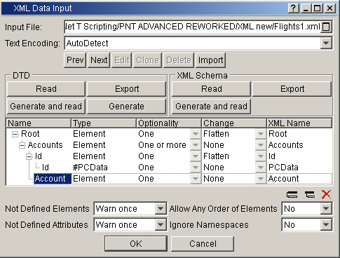
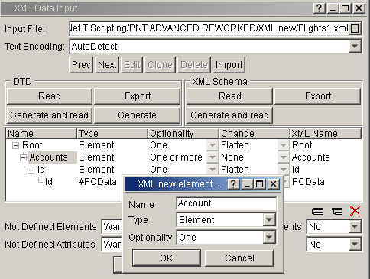
Structure Window – Structure Generation
Building XML file structure
Modifying XML file structure
Saving XML file structure
Notes:
Structure window allows you to build or modify an XML file structure. You can create new elements and sub-elements and change their properties.
Users can build the structure manually.
There are several data types:
Element – can contain other elements, text, or be empty.
Attribute – provides extra information about elements.
PC DATA – parsed character data as the text found between the start tag and the end tag of an XML element. PCDATA is text that will be parsed by a parser.
We can save the structure either by Export (DTD) or Export (XML).

Slide 7
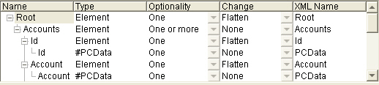
Structure Window – Optionality
Optionality
Node information and settings
Notes:
Optionality – Defines whether the element is required and repeatable. Values must be set according to the XML input file – they reflect its structure and the occurrence of each element.
Optionality One means that if:
This is final node, it is a string (customer’s name – must exist).
This is not a final node and contains more elements (name, surname, etc.), it is a sub-tree.
One or more – at least one (e.g., required phone numbers of a customer), in Layout it is an array.
Zero or one – max once (e.g., nickname of a customer), in Layout it is an optional string, etc. Exist variable is created automatically within the array.
Zero or more – either zero or more (e.g., optional phone numbers of a customer), in Layout it is an array.
Settings – If we generate and read the schema automatically there are no errors, because the system will handle the optionality. If we generate the schema manually we must keep in mind the occurrence of data inside XML files (one record will have three transactions and the second record no transactions, so the optionality must be zero or more).
Show sample situations:
One_and_OneOrMore_Functionality.wfd – no elements or sub-elements missing (One_OneOrMore_Functionality.xml input file)
ZeroOrMore_Functionality.wfd – data of a particular customer is missing (element-Zero-More, sub-element-One) – (ZeroOrMore_Functionality.xml)
ZeroOrOne_Functionality.wfd – part of data of a particular customer is missing (element-Zero-More,sub-element-zero-one) – (ZeroOrOne_Functionality.xml)

Slide 8


Optionality – Example
Suppose there are two types of arrays:
The first (Transactions) contains more records
The second (ID, account, sum) contains only one record
The structure looks like this:
^{XML Data Input Structure}
^{Layout structure}
Notes:
ZeroOrOne_Functionality.wfd
Since Transactions array contains no or more records, it has ‘Zero or more’ optionality.
Since ID, account, sum array contain only one record their optionality is identified as ‘One’.

Slide 9
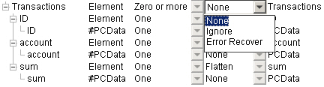
Structure Window – Change
None
Ignore
Flatten
Error Recover
Notes:
We can specify the change which will be applied on, e.g., an element. This change will be applied for further processing.
Changes can be of the type:
None – No change is applied (the default value).
Ignore – The node is not used for further processing in the workflow. It is ignored.
Flatten – When selected for an element, the element itself is 'skipped' in further processing and its subnodes are 'moved up' one level. This is for simplifying the structure. It basically means that this particular element will be neglected, but not its contents.
Error Recover – It is used for Error Recovery purposes. If an element is, e.g., missing, and users select Error Recovery, then there is a new boolean variable created within the mentioned array.
XML Name – The name of the node used within the XML file, this name must be specified in the Structure window exactly as stated inside XML file.

Slide 10
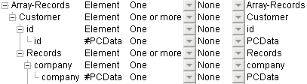
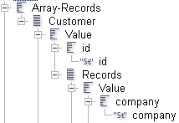
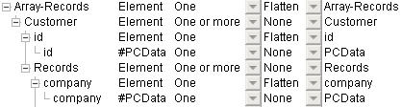
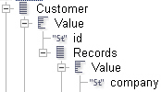
Flatten Option – Example
If Flatten option is not used, the data structure will be more complex:
If Flatten option is applied, the data structure is simplified:
Notes:
Flatten.wfd
It does not matter that the flatten option was used because no data have been lost. The reason is that the arrays which have been flattened contain only one value; therefore, it does not matter when the array has been eliminated and its content – one value – has been moved one level up.

Slide 11

XML Data Input – Tutorial I
Import an XML file, define its structure manually, parse and display all its data in Layout.
Drag and drop an XML Data Input module into workflow
Select input file Flights1_2.xml
Create a data structure manually according to XML content:
    Accounts
      Id
      Transaction including Date, Company, Flight ID, Origin and Destination
Notes:
Manual_Definition
Look into Flights1_2.xml file so you will know what its structure is. Based on this information we can construct the XML schema. Every time you define a new element , look at that particular element in the XML file, and, based on this, define it in XML Data Input.
Normally, manual definition is not used, because we have auto-detection available. If we also have a reasonably defined XML sample file, we can use only auto-detection. Suppose that we receive a different XML which contains also some optional data, etc.; then, we have to define these optionalities manually.

Slide 12
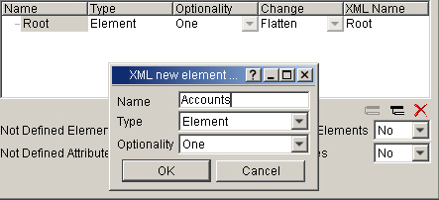
Tutorial I – Creating Structure
Import an XML file, define its structure manually, parse and display all its data in Layout.
Data structure is specified by clicking on Create new sub-element button
To create Accounts element, click on Root element and click the button
Specify the name and its occurrence (One or More, because there is more than one account)
Notes:
The name for Elements we specify is the name which will be copied automatically into Name and XML Name column, so they will be identical.
If the name under XML Name column does not match the name in XML file, PrintNet T will not recognize the file content.
It is important to specify the name in XML Name column the same way as stated in XML file.
The name in the Name column can be specified according to users (this name will appear in Data structure in Layout).

Slide 13
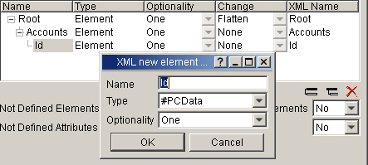
Tutorial I – Creating Structure
Import an XML file, define its structure manually, parse and display all its data in Layout.
Create a sub-element, “Id”, of the element Accounts in the same way
Select the element “Id”, click Create sub-element again and create a new sub-element
This sub-element is of a type #PCData (information from XML is parsed into this field)
Notes:
The XML Name of element ID must be Id, as in the XML file.
The XML Name of #PCDATA ID can be any name.

Slide 14
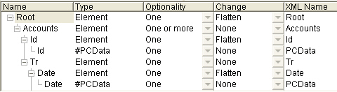
Tutorial I – Creating Structure
Import an XML file, define its structure manually, parse and display all its data in Layout.
Continue adding more sub-elements (Company, FlightID, Origin, Destination)
Add their corresponding #PCDATA
Note that for specific elements there is the option “Flatten” applied
The option “Flatten” simplifies the data structure
Notes:
If there is no Flatten option applied then there will be a complicated Data structure with one array for each variable.
One record in an array does not mean that displaying this record can be done only by repeating by this array. It can simply be dragged and dropped into a flow area where we would like to display this array.

Slide 15
Tutorial I – Displaying Data
Import an XML file, define its structure manually, parse and display all its data in Layout.
After you finish defining the XML structure, create a table in Layout displaying all the imported values
Press <F6> to proof the job
Switch to data and look at the data structure
Resolution in Manual_Definition.wfd

Slide 16
Accessing XML Files – Exercise
Access an XML file, define its structure, parse it and display it in Layout.
Import the XML file Customers1.xml
Define its internal structure manually
Specify the structure to be convenient for displaying it in Layout
Display it in Layout
Check the result in Manual_Definition2.wfd

Slide 17

Difference Between DTD and XML Schema
The difference between DTD and XML Schema is that they use slightly different languages.
DTD – Document Type Definition, the purpose of a DTD is to define the legal building blocks of an XML document. It defines the document structure with a list of legal elements.
Notes:
Why use a DTD?
XML provides an application independent way of sharing data. With a DTD, independent groups of people can agree to use a common DTD for interchanging data. Your application can use a standard DTD to verify that data you receive from the outside world is valid. You can also use a DTD to verify your own data.
Using these buttons you can use an already existing DTD file (Read) that is the file which is delivered with XML file, generate a DTD file (Generate and read) from the loaded XML file, or create a DTD file based on the structure defined in the structure window (Export).
After pressing Generate DTD button, the parser will:
parse the XML file specified in the Input file field
generate the DTD file according to the XML content
save the resulting DTD file in the location specified in the “Save as” dialog
After pressing Generate and read DTD button, the parser will:
parse the XML file specified in the Input file field
generate the DTD file according to the XML content
load the DTD file content (the structure) into the structure window
Customers might send the input data in various ways. They can send an XML file along with DTD file. Also they can send an XML file along with XSD structure. It depends on the customer and their preferences and/or needs.
Read DTD: Reads the already existing DTD file describing the structure of the XML file specified in the Input file field.
Read XML Schema: Reads the already existing XSD file describing the structure of the XML file specified in the Input file field.
Export DTD: Reads the structure defined in the structure window and saves the DTD file in the specified location.
Export XML Schema: Reads the structure defined in the structure window and saves the XSD file in the specified location.
Generate and read DTD or XSD: Creates a data structure of an XML file and reads it.

Slide 18
XML Data Input – Tutorial II
Import a sample XML file, define its DTD structure and then use the same DTD structure on a similar production XML file.
Open Structure_Definition.wfd
The input file is Flights1.xml
Read the DTD schema DTD_Wrong_Structure.dtd and proof the job
Change the input file to be Flights1_1.xml
Use the same DTD structure as defined for the sample file Flights1.xml
Run the proof (there is an error that data is not matching definition)
Use the same input file, but read the DTD structure file
DTD_Correct_Structure.dtd
When you run proof, the job will be proofed correctly
Notes:
Description of process:
We received a sample XML file: Flights1.XML.
We created a DTD definition based on contents of the sample XML file.
We received a production XML file Flights1_1.XML which has similar contents as the sample file, but some elements appear with a different functionality (some are missing for particular customers, etc.).
When we apply the same DTD schema as we did for the first file the solution it will not work, since this new file has different elements optionality. Proofing will cause an error.
That is why we have to define a different DTD structure definition.
This definition works for both XML files.
Note: This example and functionality works also for XSD schema.
Note: You can use DTD_Correct_Structure.dtd for definition of both input files.

Slide 19
Saving XML Structure – Tutorial
Use XML structure and export it into DTD or XSD files.
Drag and drop an XML Data Input module into a workflow and specify the input file to be Flights1.xml
Click the Generate and read button in XML Schema section
The data structure will be displayed
Click Export either in DTD or XML Schema section
Type the name of the file where the structure will be stored
Replace your XML Data Input module with a new one and click Read either in DTD or XML Schema section
Select file for reading. This will load your defined data structure
Display the data in Layout, press <F6> to view the result
Notes:
Note that for importing an XML file, you must specify the input XML file and also its generated structural file (XSD or DTD).

Slide 20
Saving XML Structure – Exercise
Use XML structure and learn how to handle the ‘EXISTS’ variable.
Import the XML file Customers2.xml
Automatically generate its structure
Take care of the node in which the optionality is set to “Zero or One” (change Flatten option to None and view the array in Layout, it contains the Exists variable)
Display all the data in Layout in a customer table. If a customer does not have a Middle Name, specify that this record is only preview and not for use
Resolution is in Exists_Variable.wfd
Notes:
Exists variable is equal either to 1 (variable exists) or 0 (variable does not exist).

Slide 21
Creating XML Files – Tutorial I
Install an XML editor, create an XML file and access it in PrintNet T.
Install XML Notepad from: http://www.microsoft.com/downloads/thankyou.aspx?familyId=72d6aa49-787d-4118-ba5f-4f30fe913628&displayLang=en
Run XML Notepad and follow the instructions:
Notes:
There are two ways of creating XML file:
Manual – more difficult
Automatic – easier, possible to generate in PrintNet T.

Slide 22
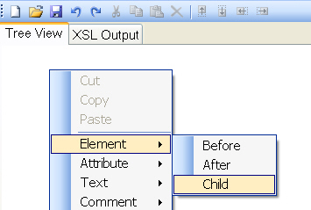
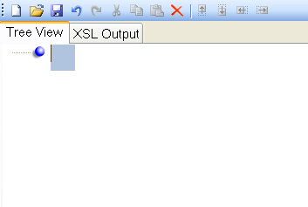
Creating XML Files – Tutorial I
In this XML Notepad, right-click into Tree View and select
Element | Child
Type in “Accounts”
Notes:
First, show the trainees the file Customers3.XML and ask them to define the same XML manually in XML notepad.

Slide 23
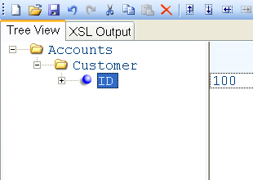
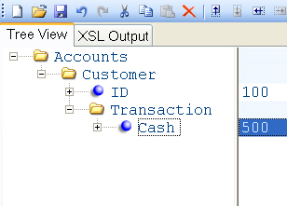
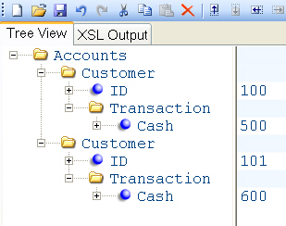
Creating XML Files – Tutorial I
Create a child element “Customer” and its child element “ID”
Click into the right part of the window and type in the value of “ID”
Create the element “Transaction” and its sub-element “Cash”
Fill in the value of “Cash”
Right-click on “Accounts” and select Element | Child and create a new element “Customer” with same data structure as the previous one
Notes:
The structure of the second customer does not need to be exactly the same, there might be some variable missing. Therefore, this will be fixed in XML Data Input in Optionality column (Zero or More/One).
Test this XML file in XML Data Input and proof the result.
Resolution in Creating_XML.WFD, created source Customers3.XML

Slide 24
Creating XML Files – Tutorial II
Merge several data files together and create an XML and TSD file.
It is also possible to create an XML file in PrintNet T
Several, e.g., .TXT files are merged together using 1-1 Merge or 1-Many Merge modules
A Data Output module can be used to create an XML file from the merged data.
Notes:
Even though processing of XML is faster than merging several corresponding CSV, DBF, TXT files or other resources, we do not need to generate an XML file for our project and use it. In this case, the creation of XML serves when we need to save the XML into our archive, etc.
In our example, the keys for merging will be TripID and MemberID.

Slide 25
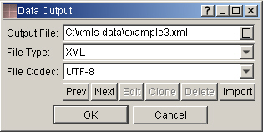
Creating XML Files – Tutorial II
Merge several data files together and create an XML and TSD file.
Open the sample workflow Files_Merging.wfd
Merge input files together and drag and drop a Data Output module
Double-click to open it, and specify output file and file type (XML)
Run production by pressing <F5> and start it
Check your result
Try to access the file via XML Data Input module
Notes:
The output file will be created only by running production (<F5>) not by running proof (<F6>).
Resolution in Files_Merging2.WFD

Slide 26
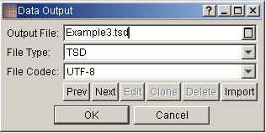
Creating TSD Files – Tutorial II
Merge several data files together and create an XML and TSD file.
Open the sample workflow Files_Merging.wfd
Merge input files together and drag and drop a Data Output module
Double-click to open it, and specify output file and file type (TSD)
Run production by pressing <F5> and start it
Check your result
Try to access the file via Internal Data Input module
Notes:
The difference between XML and TSD:
When creating an XML out of .CSV and .TXT files, it is saved and later on, when accessing it, it needs to be parsed (consumption of time).
When creating a TSD file out of .CSV and TXT files, it is saved and later on, when accessing it, it does not need to be parsed.
The output file will be created only by running production (<F5>) not by running proof (<F6>).
Resolution in Files_Merging2.WFD

Slide 27

XML Data Input – Summary
In this presentation we have learned:
The basics of TSD and RDI files
The basics of XML files
About structure definition and simplification of XML files
How to create XML files manually and automatically
How to access XML files

Slide 28

XML Data Input – Discussion
Is there an advantage of using an XML file rather than using other file formats (.TXT, .CSV, .DBF, etc.) and merging them?
What does the “Zero or More” functionality mean?
Why would the “Flatten” option be used?
Is it enough to always create the XML data structure automatically, or do we need to specify some parts manually?
Notes:
1. Is there an advantage of using an XML file rather than using other file formats (.TXT, .CSV, .DBF, etc.) and merging them?
XML processing is faster than merging other files (.TXT, .CSV, .DBF, etc.) together. Some customers generate XML files for archiving purposes.
2. What does the “Zero or More” functionality mean?
Zero or more – e.g., optional phone numbers of a customer; in Layout it is an array.
3. Why would the “Flatten” option be used?
Simplification of data structure.
4. Is it enough to always create the XML data structure automatically, or do we need to specify some parts manually?
No, when we generate the structure automatically based on an incomplete sample file, and later on receive a production file which has a little bit of a different structure, we need to redefine our XML file manually.

Slide 29

Thank You.
Do You Have Any Questions?

